Slide 1
Debugging React

Slide 2
Debug instruments
Debugging in the browser
Debugging with IDE(WebStorm, VS code)
React Developer Tools
Redux DevTools Extension
Notes:
In software development, debugging involves locating and correcting code errors in a computer program. A good software engineer must know how to properly debug an application in his language of choice.

Slide 3
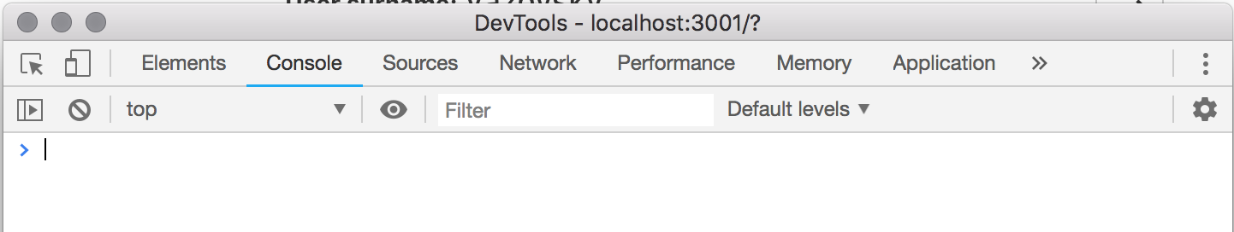
Debugging in the browser
Press F12 or Ctrl+Shift+I(Cmd+Option+I for Mac) or right click inspect you can get inspect element window.
Notes:
First we will see that browser’s development tools, that is already available to you. all that go with “inspect”. We have several very useful tabs: Elements, Console, Sources, Network.

Slide 4
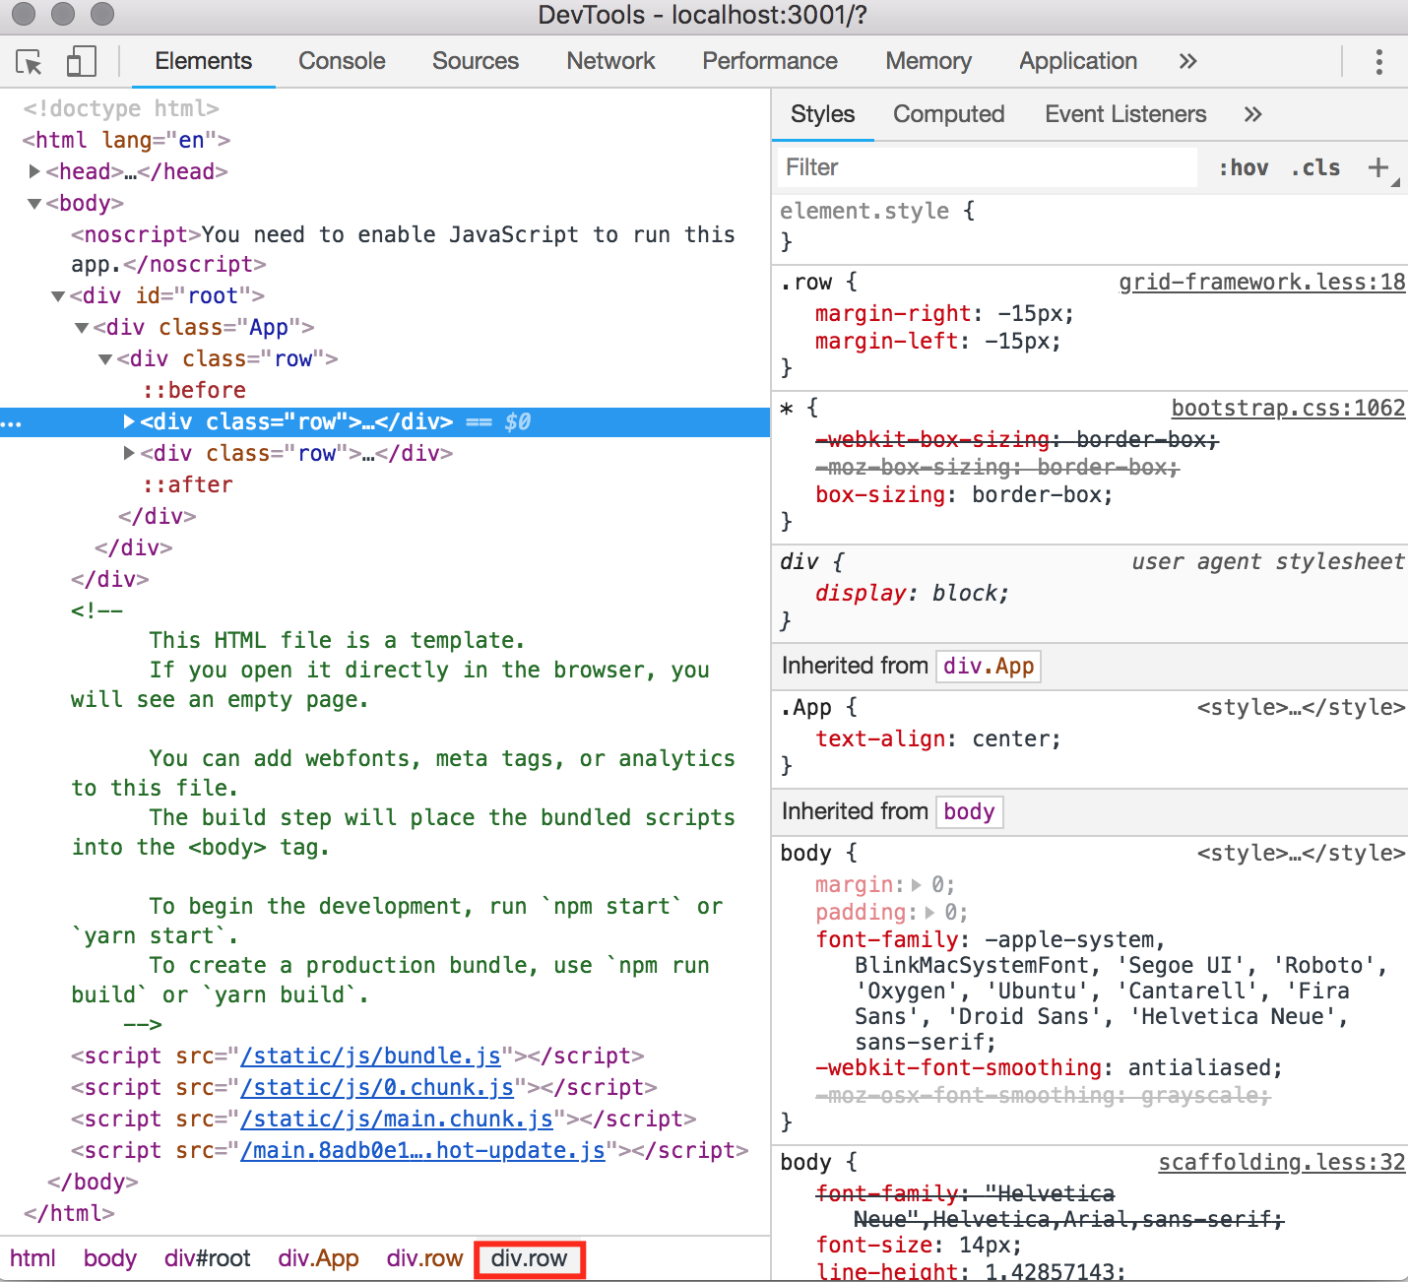
Element Panel
Notes:
Elements panel. View and change the DOM and CSS. What we can do in this tab?
View an element's CSS. The Styles tab on the Elements panel lists the CSS rules being applied to whatever element is currently selected in the DOM Tree. The fact that you see this rule means that it's being applied to the element.
Need Demonstration We can add a CSS declaration, CSS class, pseudostate, change the dimensions of an element, live-edit a DOM node, live-edit a style, examine and edit box model parameters.

Slide 5
Console panel
The Console has two main functions:
Viewing diagnostic information about the page. This information can come from the web developers that built the page, or from the browser.
Running JavaScript. You can view and change the page’s DOM by typing JavaScript statements in the Console.
Console has several useful methods:
log
debug
error
info
Notes:
View messages and run JavaScript from the Console.
Need demonstration: Show printing message with console methods. Methods info and error has call stack leading up to those messages. Also console can view and change the page's JavaScript or DOM.
$0 – current element. Lets change background color: $0.style.background = "green”. Now we can to know offsetWidth of our element - $0.offsetWidth.
$(selector) returns the reference to the first DOM element with the specified CSS selector. $('div').innerText

Slide 6
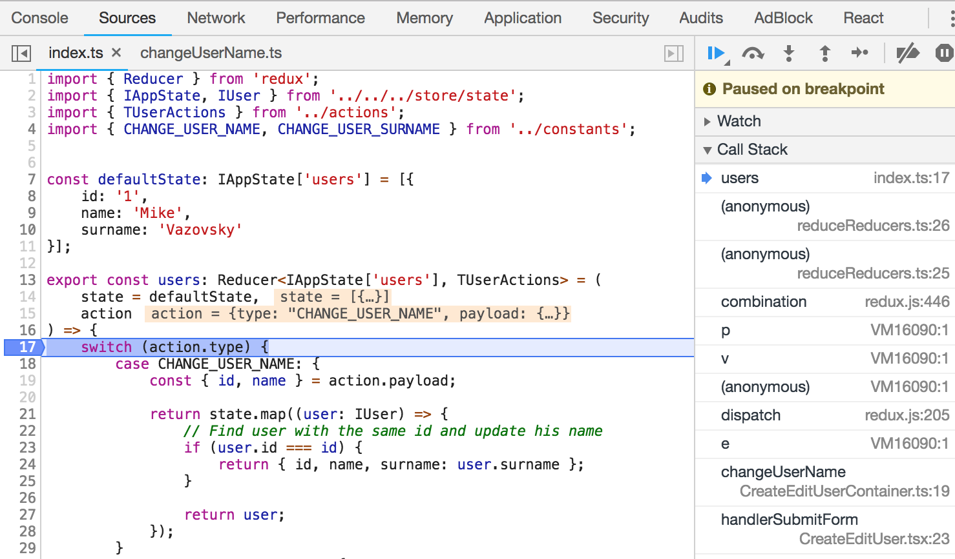
Sources panel
Notes:
Debug JavaScript, persist changes made in DevTools across page reloads, save and run snippets of JavaScript, and save changes that you make in DevTools to disk.
Need Demonstration: Let’s choose some file(Cmd+P). And add breakpoint. Step through the code. Show scope pane. Add watch expression.

Slide 7
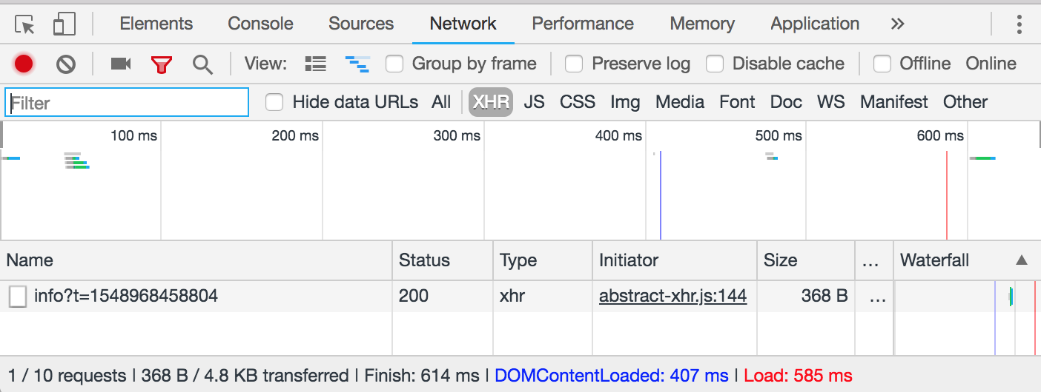
Network panel
Notes:
Network panel needs for viewing and debugging network activity.
Disable Cache checkbox. When this checkbox is enabled, DevTools doesn't serve any resources from the cache.
Online dropdown lets to simulate network connection.
Need Demonstration: reload the page and analyze the requests that come in. Note the value for DOMContentLoaded in the Summary pane. Click on some request to investigate that request further. Click the Preview tab to view the request's source code. Find large requests and and look on it waterfall.

Slide 8
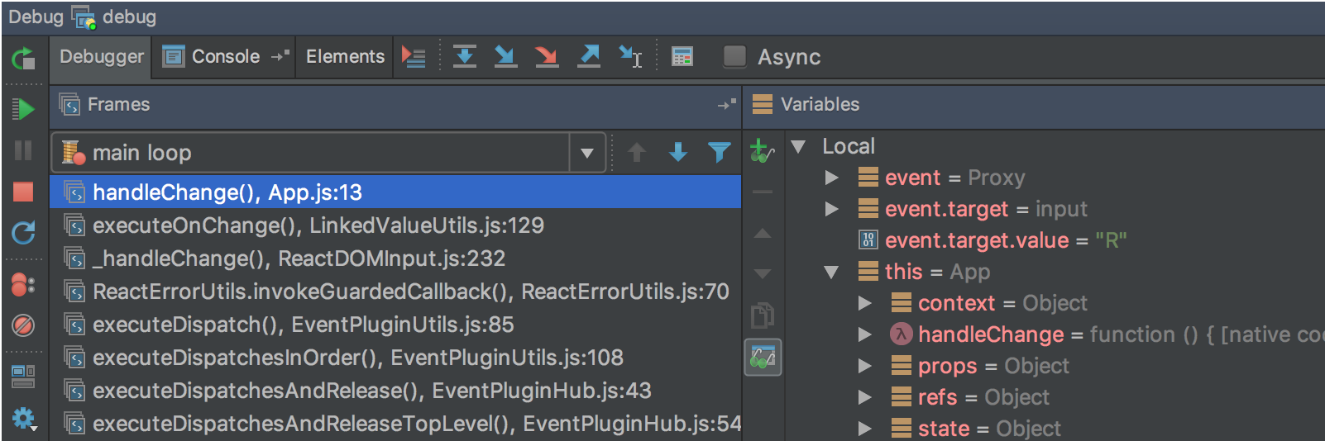
Debugging with WebStorm
JetBrains IDE Support, Debugging React apps
Notes:
Need Demonstration:
Install JetBrains IDE extension and create debugging configuration for current project. Then show how works breakpoints.

Slide 9
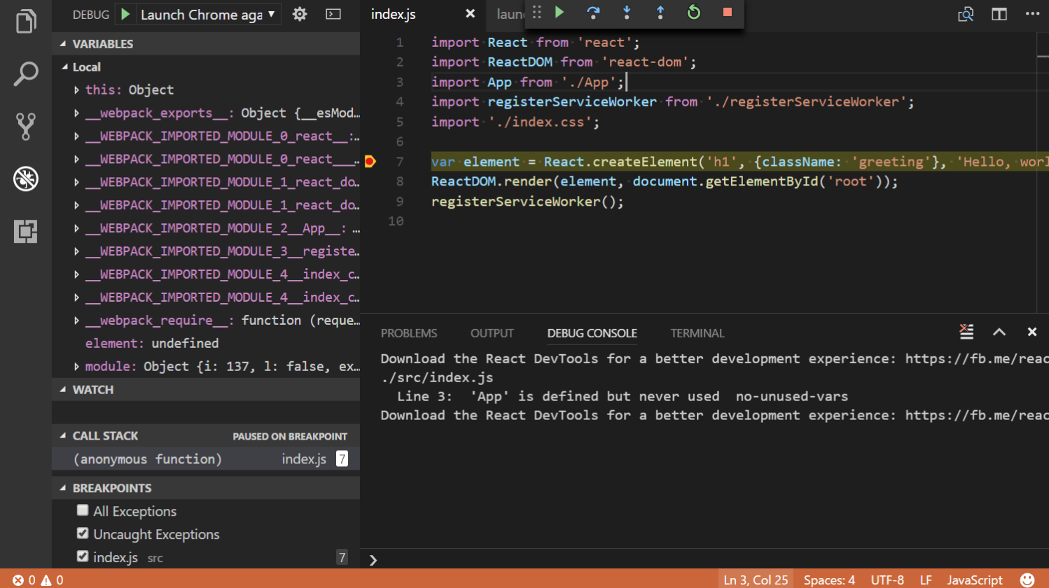
Debugging with VS Code
React debugging tutorial, Debugger for Chrome
Notes:
Need Demonstration:
Install Chrome extension and create debugging configuration for current project. Then show how works breakpoints.

Slide 10
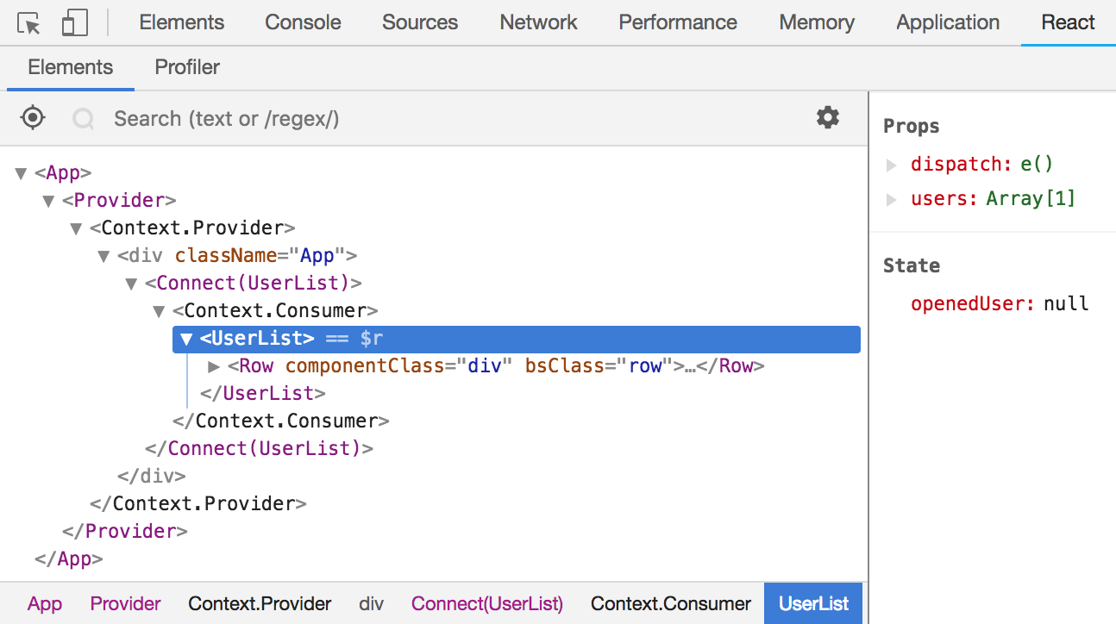
React Chrome Developer Tools
React Developer Tools lets you inspect the React component hierarchy,
including component props and state.
Notes:
Need Demonstration:
Install chrome extension. Open our app and show how it is work. Arrow keys or hjkl for navigation. Right click a component to show in elements pane, scroll into view, show source, etc. Differently-colored collapser means the component has state/context. Side pane: right-click to store as global variable, update state and show results. Show how to use search Bar: find some component.

Slide 11
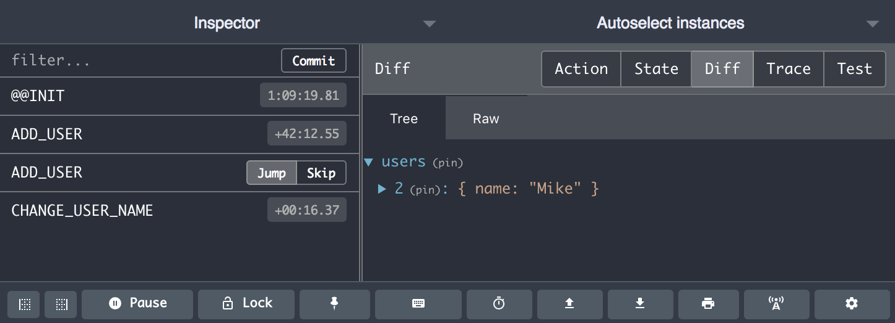
Redux DevTools
Redux DevTools
Notes:
Need Demonstration:
Install Redux DevTools extension and open our app. Make some action: add/remove user, change name or surname. Show how to change state and how launch actions. Jump or skip some action. Show state of current action.

